Slide 1


NBA Semi Final Model
Louise Ann Lalescu

Slide 2
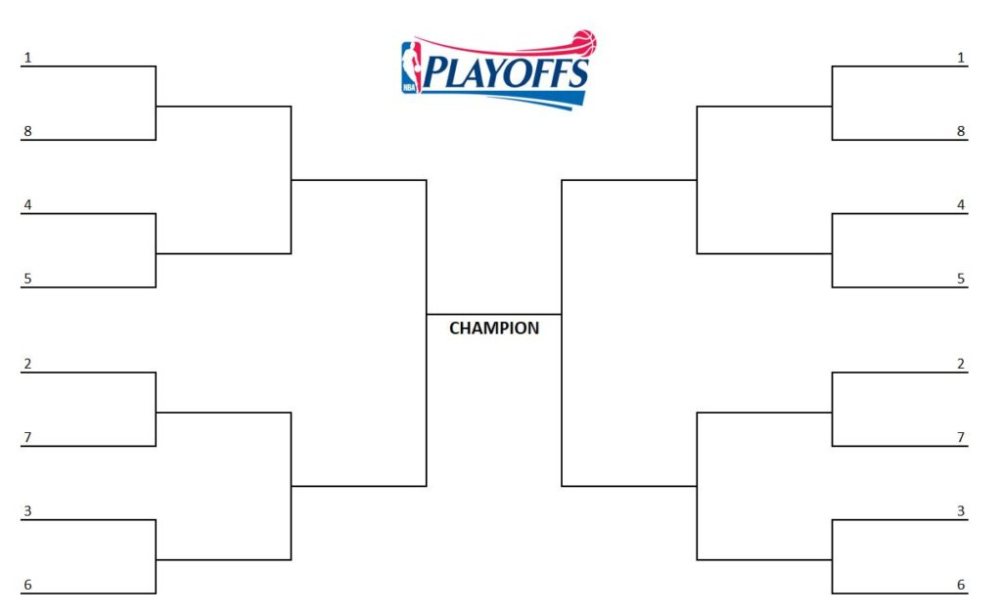

Playoff Background
Notes:
30 NBA teams, 16 in play offs, 7 game series meaning 1st team to win 5 advances to next round and losing team in eliminated. Up to here about a minute?

Slide 3
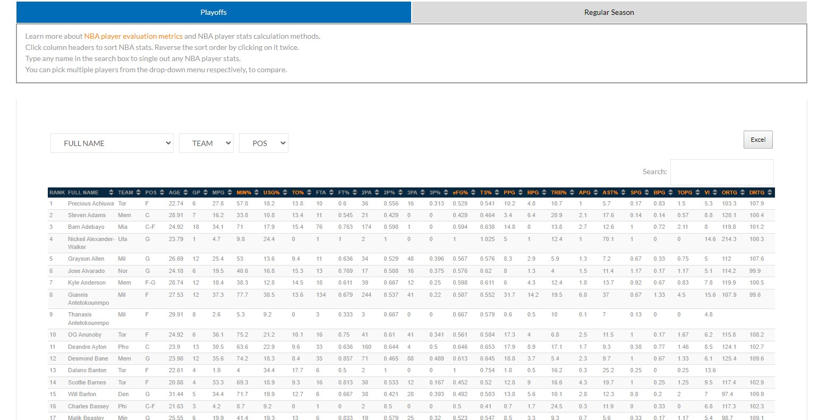
Our Data
Data downloaded from https://www.nbastuffer.com/player-stats/ and exported to excel sheet
Data of four seasons used: 2018-2019, 2019-2020, 2020-2021, 2021-2022
Only regular season data was included
Notes:
Show in video how we got the data

Slide 4
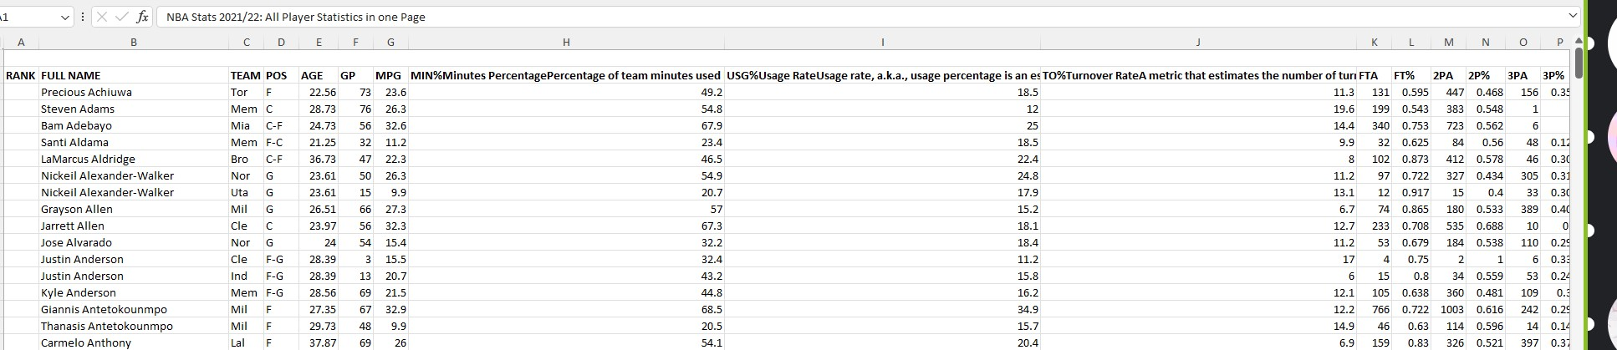
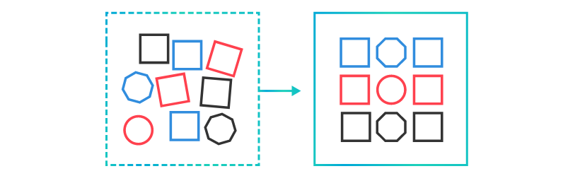
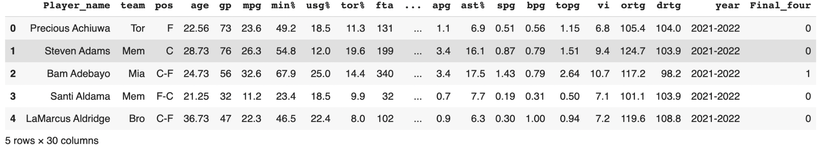
Data
1st row was removed
Renamed columns with shorter names
Added season data was from
Added binary column if team made it or not

Slide 5

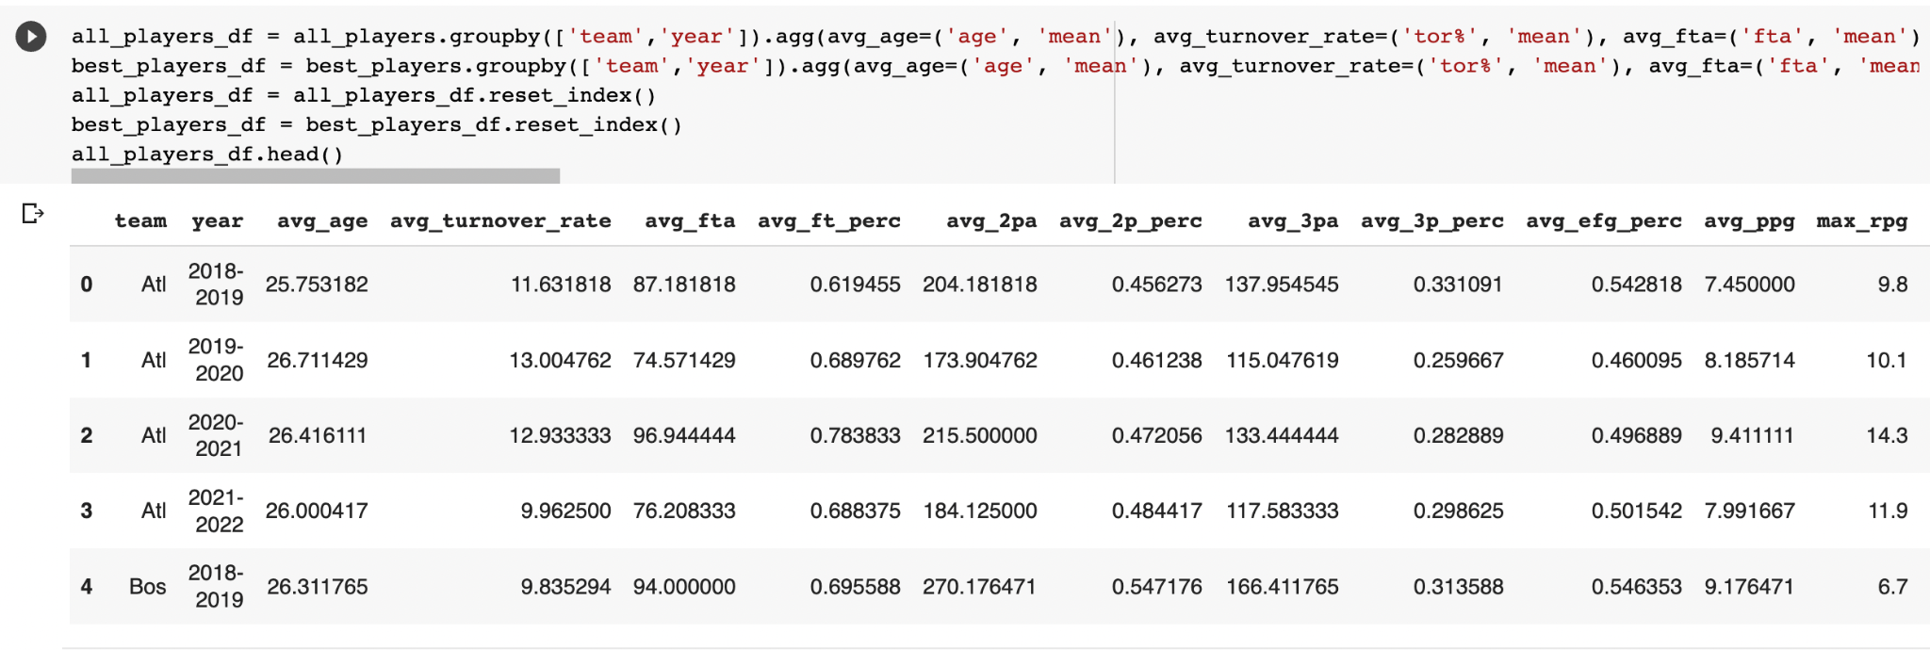
Cleaning and Manipulation
Replacing NaN with 0
We created two sets, one with all players, one with only the players who played for more than 10 minutes
Added aggregate functions on columns
Notes:
Implications of cut will be done late in the presentation

Slide 6
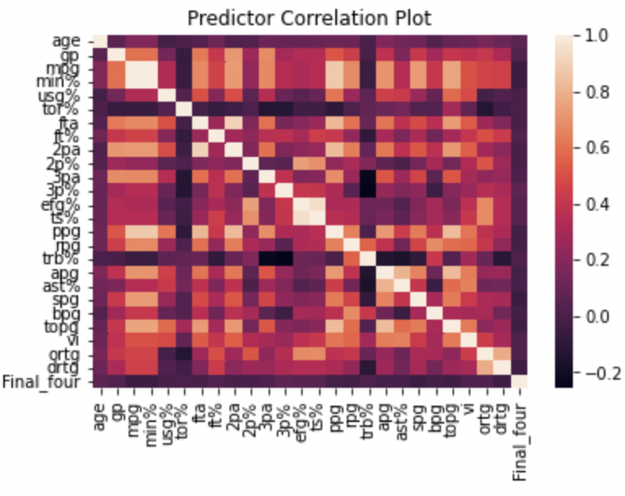
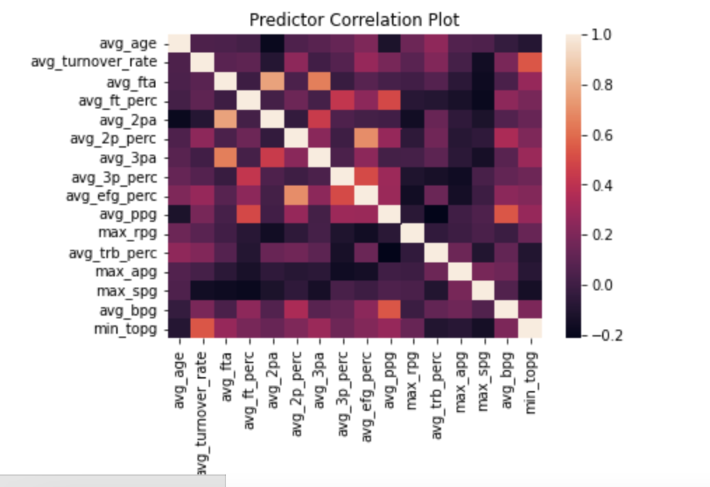
Wrangling and Creating Model
Data was split into training (70%) and testing (30%). Of this testing data, 50% was used for a development set to avoid data leakage.
After we grouped by team and applied aggregate functions to our original features (left graph), we narrowed it down to 13.
How did we decide that? Based off model performance as well correlation heat map

Slide 7

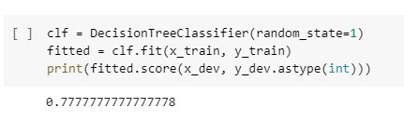
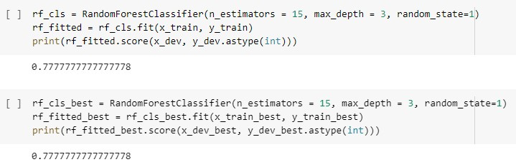
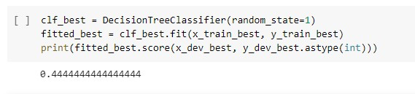
Wrangling and Creating Model
Three models were applied to both sets
Decision tree
Random Forest with 15 estimators and max depth of 3
Logistic Regression with max 1000 iterations, scaled used a standard scaler
Two models, decision tree and random forest both had equal accuracy on the full set of players. Random forest had the highest accuracy for both sets
Decision Tree
Random Forest

Slide 8

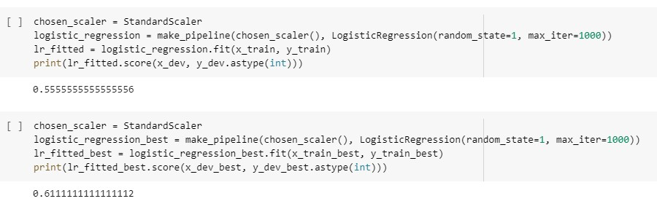
Results (Development Set)
Logistic Regression Both Sets

Slide 9
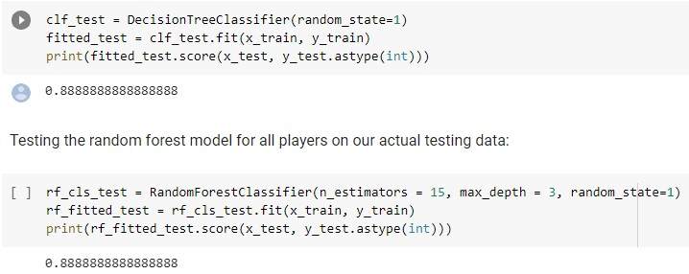
Results (Test Set)
Actual Test Results
On our actual test set random trees outperformed previous performance and all other models on other sets

Slide 10
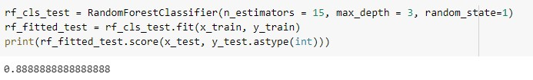
Discussion
There are not any direct comparisons for our model
Most other models look at individual games ours looks at overall outcomes of a series
For sports bettors looking too win money on winning NBA brackets our model can offer some guidance up to the semi finals
For bettors looking to make a whole bracket our model may be useful
Our best performing model performed best on both our full set and our reduced player set. This model was the random forest.
For individual games in the playoff the best performing model is at 74.1%. The average performs around 62-67%
Notes:
and my intuition leads me to believe it may be tied to sample size.

Slide 11
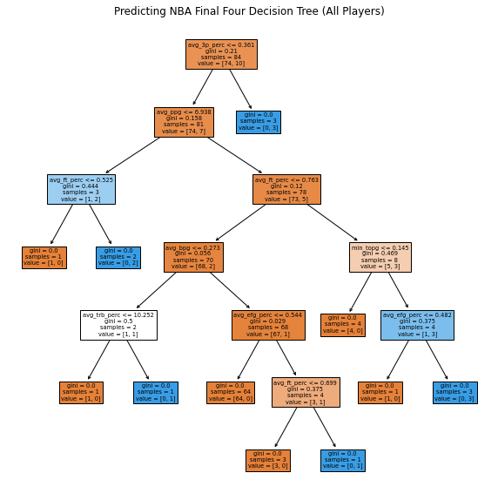
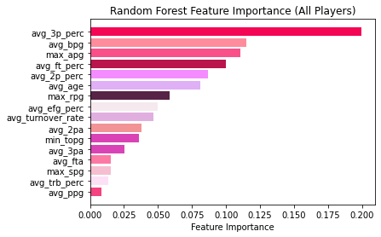
In Depth Look at Predictors for Our Best Performing Models

Slide 12
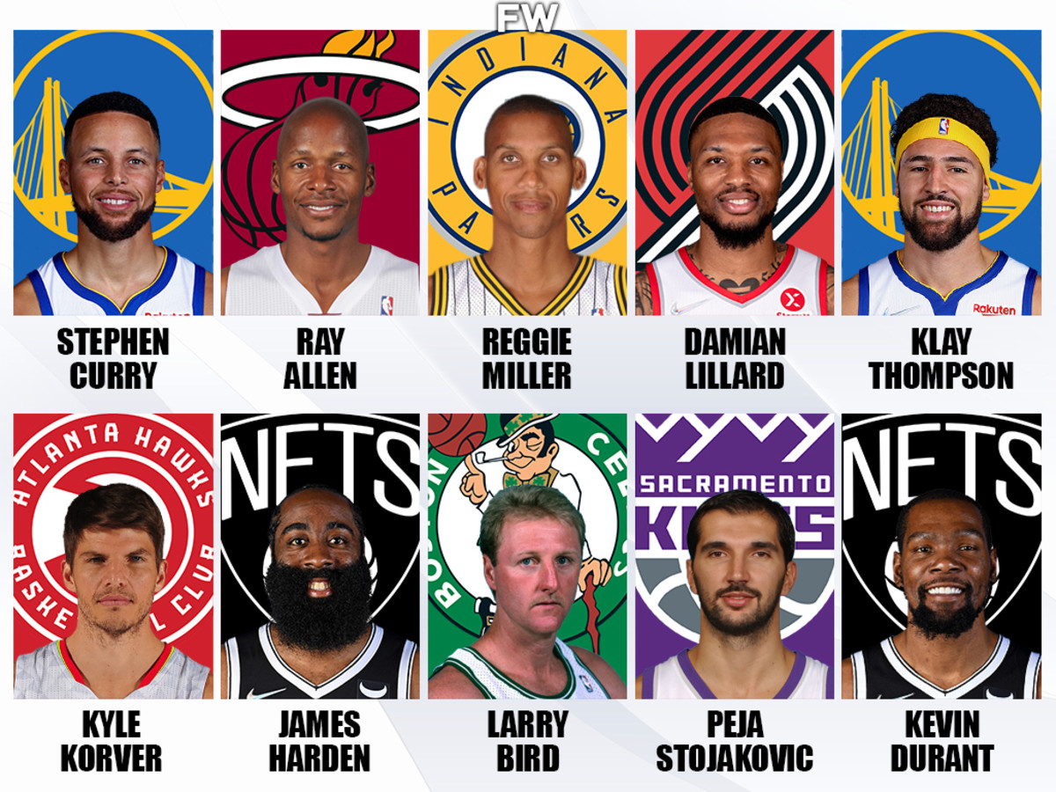
The Importance of 3-pointers
Steph Curry is the best 3-point shooter of all time
Taken his team to the playoffs 8 time and finals 6 times in his 14 season career
New age of basketball has more emphasis on good 3-point shooter
In our findings 3-point percentage was not a common metric used
Common metrics are home team advantage, win percentage, rebounds, asists, steals, blocks, score, offensive rating, defensive rating, and true shooting percentage
TS% - True Shooting Percentage; the formula is PTS / (2 * TSA). True shooting percentage is a measure of shooting efficiency that takes into account field goals, 3-point field goals, and free throws.

Slide 13
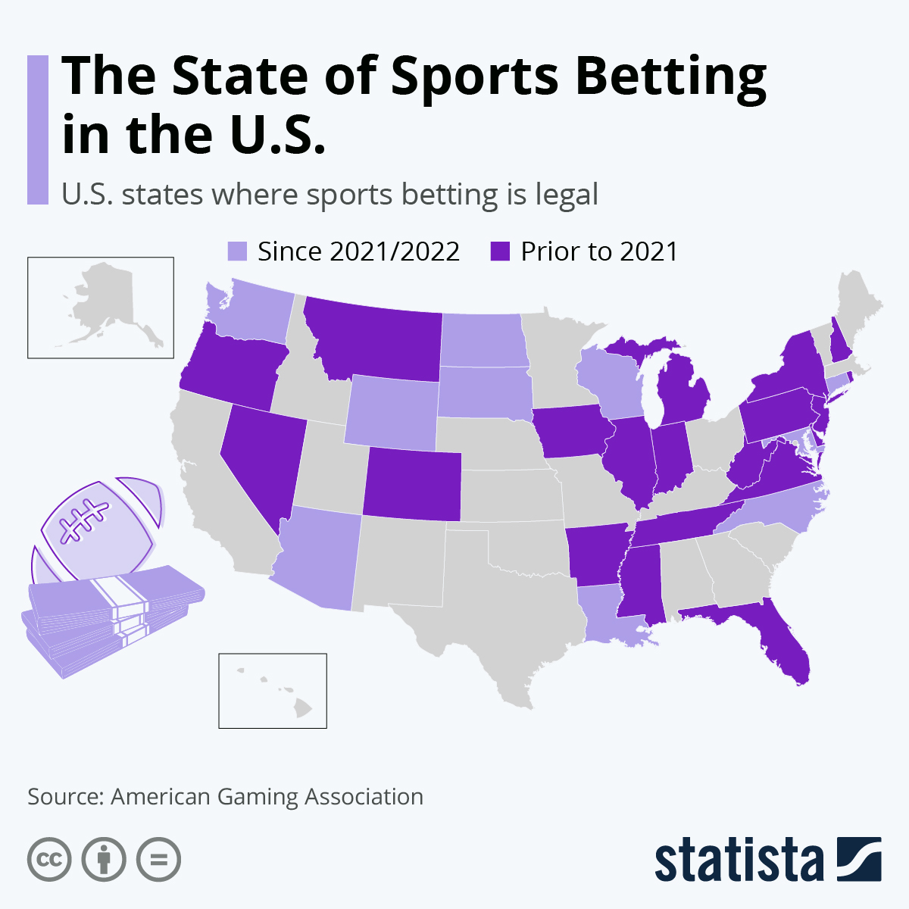
Era of Sports Analytics
Coaches, teams, and NBA as a whole is moving towards using models to help recruit, draft, and reorganize teams to win
Individuals, like us, can also create their own models and calculations with ease now
About half of states legalized sports betting
The demand for analytics to help people win bets is rising

